Slide 1
Skip Lists

Slide 2
Overview
Linked list based alternative to search trees
A hierarchy of h linked lists
First (bottom list_ – original linked list – n sorted items
i-th list – part of list at level i-1
Optimally, every second element in level i-1 is in level i
Top list
Constant number of elements
Optimally – two elements
Extra headers for each list (single top header is often sufficient)

Slide 3
Search (L, key)
Let node be head of list (left upper level)
While (true)
If (node=Null) return failure
If (node->key=key) return node
If (node->next ≠ Null)
If ((node->next)->key ≤ key)
node←node->next
Else
node←node->down
Time complexity – sum of steps at each level
Optimal – O(log n)

Slide 4
Maintaining a Skip List
“Good” distribution
For every ~d elements in level i-1 there is one level in level i
Parameter d can be tuned to system
Challenge
Maintaining good distribution after insertion & deletion
Two approaches
Deterministic
Random

Slide 5
Deterministic Skip List
Consider 2-3 tree
Connect every level in linked list
In every internal node store minimum of sub-tree
Add Headers to each level
Add Null to end of each list

Slide 6
Det. Skip List - Insertion
Similar to insertion in 2-3 tree
Insert (L, x) proceeds by
Find location of x at bottom level (level 1)
Add x to bottom linked list
If gap in second level is at most 2 – terminate
If gap is 3, add middle element in gap from level 1 to level 2
Continue upwards

Slide 7
Det. Skip List - Deletion
Similar to deletion in 2-3 tree
Delete (L, key) proceeds by
Search for x at bottom level and remove it
If gap in second level is at least 1 – terminate
If gap is zero and a neighbor gap is 2
Move key at second level to middle of the two gaps
Propagate key change to upper levels
If gap is zero and neighbor gap is 1
Remove key from second level
Continue to upper levels

Slide 8
Short Aside
Amortized analysis
Probabilistic analysis for random data structures

Slide 9
Amortized Analysis
Goal:
Tighter analysis of n operations
Definition: amortized time of an operation is (time for n operations)/n
Intuition: useful if many cheap operations and a few expensive operations
Methods of analysis
Aggregation – analyze n operations together
Accounting (piggy bank) – pay constant extra for each cheap operation, balance pays for expensive operation, balance never negative
Potential function – Generalization of accounting, payment is function of system state

Slide 10
Example – Stack as Array I
Stack implemented as array
Index top initialized to 0
Push (x)
If (top<n-1)
Array[top]←x
top←top+1
What happens if top=n-1, i.e. array overflows?
Options:
Return error
Allocate new, bigger array and move stack

Slide 11
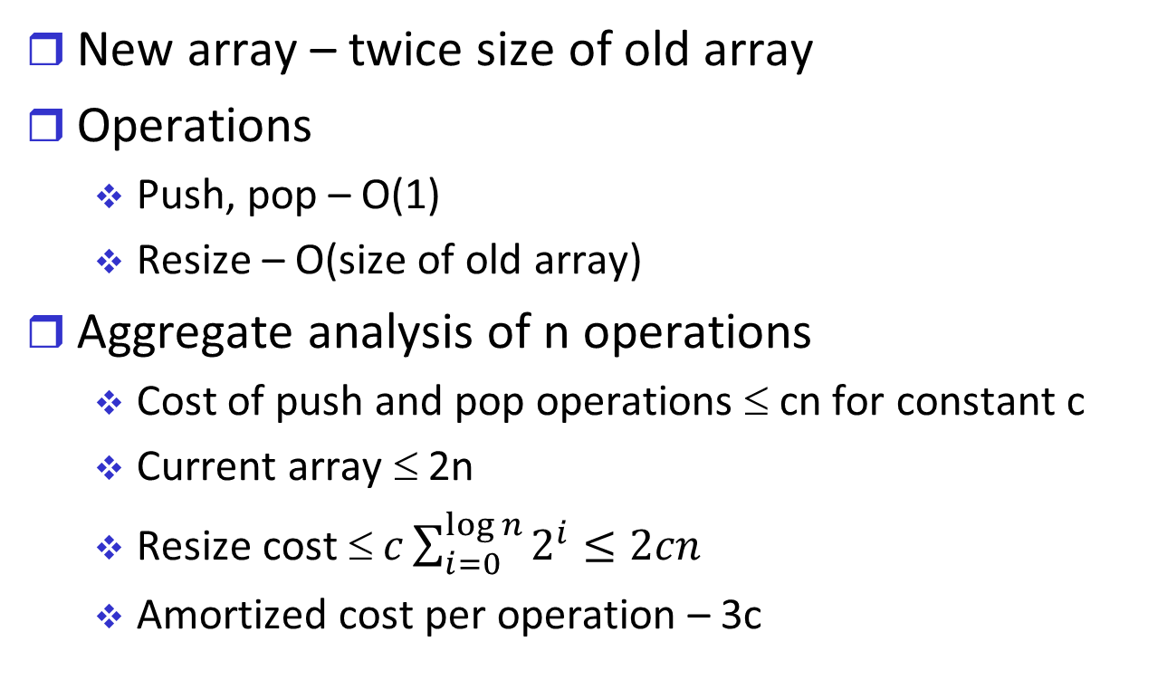
Example – Stack as Array II
New array – twice size of old array
Operations
Push, pop – O(1)
Resize – O(size of old array)
Aggregate analysis of n operations
Cost of push and pop operations ≤ cn for constant c
Current array ≤ 2n
Resize cost ≤ $c\sum_{i=0}^{\log{n}}{2^{i}≤2cn}$
Amortized cost per operation – 3c

Slide 12
Example – Stack as an Array III
Accounting analysis:
For each push operation – pay 3c coins
Current cost – c
Bank balance increases by 2c coins
Pop operations – pay c coins
Resize operations – at least n/2 push operations in current array ➔ ≥n coins in bank

Slide 13
Example – Inorder Walk
T is a search tree
Number of children at most d for each node
Inorder is equivalent to n times next operation
Next
Worst case complexity – O(log n)
n times next = O(n log n)
Potential function analysis
Payment for next – 2×number of edges from node to next node
Balance never negative – each edge traversed twice
Number of edges is n-1
Amortized cost for next O(1)

Slide 14
Random Data Structure I
DS algorithms toss coins
Algorithm operation is “random”
Complexity depends on coin tosses
This is not average case analysis!
Coin tosses do not depend on input!
Useful types of measures
Expected complexity
Low probability for “bad” complexity

Slide 15
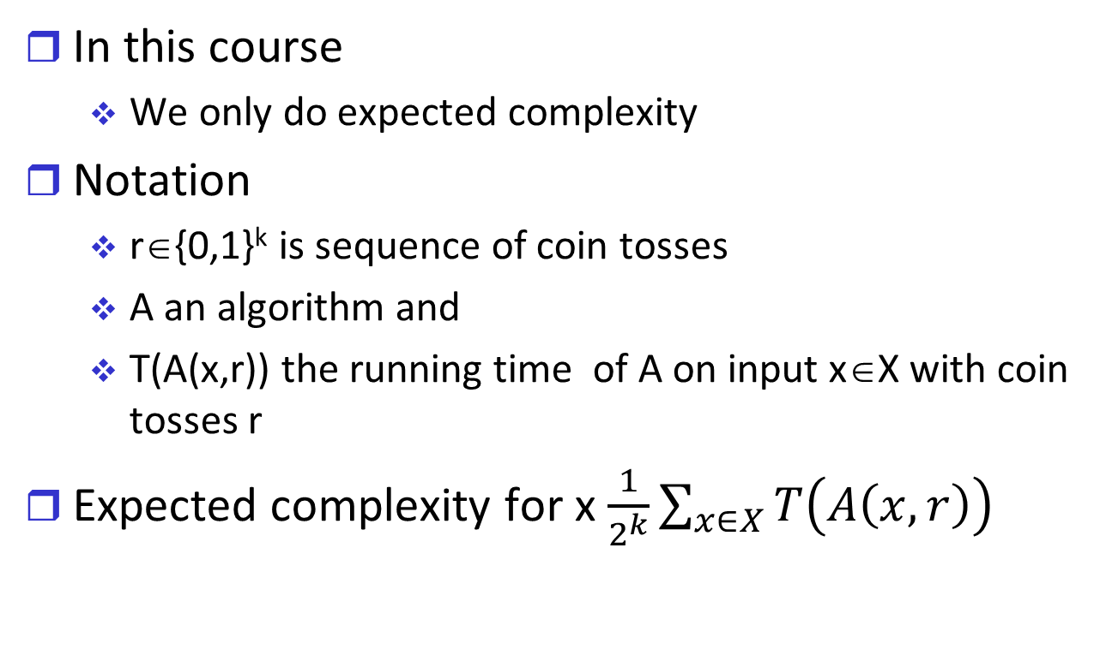
Random DS II
In this course
We only do expected complexity
Notation
r∈{0,1}^{k} is sequence of coin tosses
A an algorithm and
T(A(x,r)) the running time of A on input x∈X with coin tosses r
Expected complexity for x $\frac{1}{2^{k}}\sum_{x∈X}{T\left(A\left(x,r\right)\right)}$

Slide 16
Adversarial Considerations I
Adversary – attempts to reduce DS efficiency by providing bad input
Way to analyze worst-case inputs
Adversaries actually exist in certain situations: e.g. public Internet
Deterministic DS
DS already anticipates worst-case inputs
Random DS
Coin tosses independent of input at DS generation ➔small probability of bad DS regardless of input

Slide 17
Adversarial Considerations
After DS creation
Majority of DS is “static”
DS changing input (e.g. insert/delete) may lead to bad performance
If random coins depend only on insertion / deletion operation and not on existing structure
Adversary can take advantage of this phenomenon
However, outside the scope of our course
We will assume that all input is independent of coin tosses

Slide 18
Random Skip Lists

Slide 19
Overview
Bottom linked list contains all items
Key appearance in upper layers based on coin tossing
Less structure than deterministic skip list
Easier implementation
Search
As in any skip list

Slide 20
Insert and Delete
Insert (L, x)
Insert x in bottom level at appropriate location
For every level from second level to top level
If x exists in lower level, allocate a node for x in current level with probability p
The probability p is constant
Typically ½
Variant
Top level must be log n
Delete – remove x from all levels

Slide 21
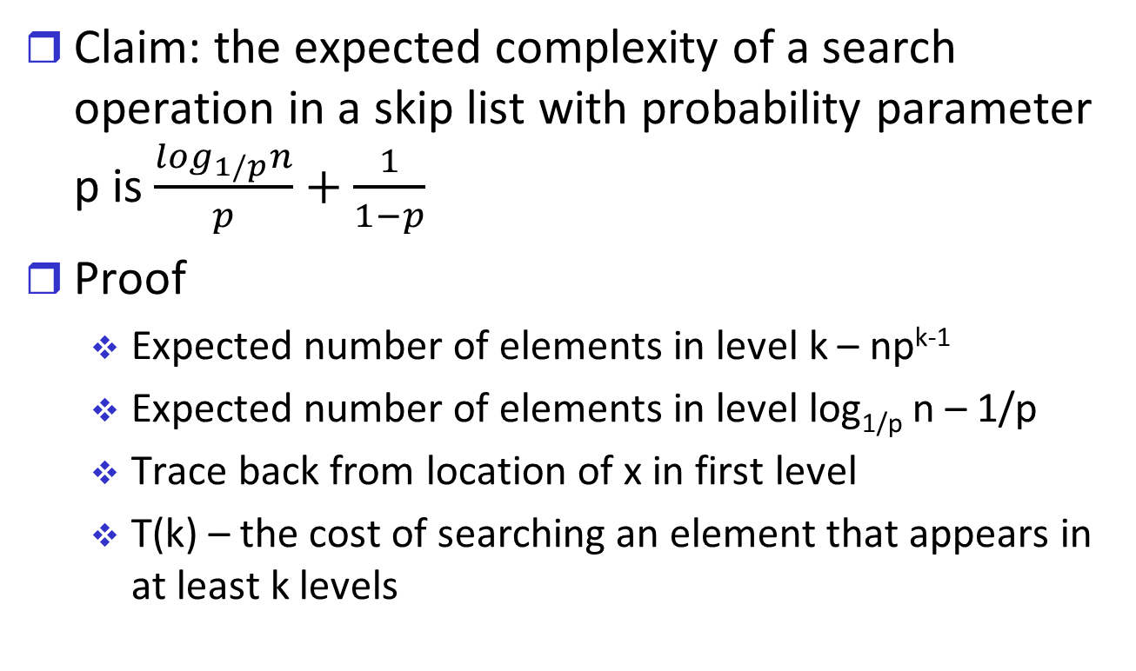
Expected Complexity of Search I
Claim: the expected complexity of a search operation in a skip list with probability parameter p is $\frac{\log_{1/p}n}{p}+\frac{1}{1−p}$
Proof
Expected number of elements in level k – np^{k-1}
Expected number of elements in level log_{1/p} n – 1/p
Trace back from location of x in first level
T(k) – the cost of searching an element that appears in at least k levels

Slide 22
Expected Complexity of Search II
At each point:
If point in not level header then with probability p there is an element above the current point
If point is level header then there is an element above it with probability 1
(*) T(k)≤(1-p)(1+T(k))+p(1+T(k-1))
➔T(k)≤1/p+T(k-1)
➔T(k)≤k/p ➔T(log_{1/p}n)≤(log_{1/p}n)/p
Once the search reaches level log_{1/p}n the expected number of elements in the level is 1/p

Slide 23
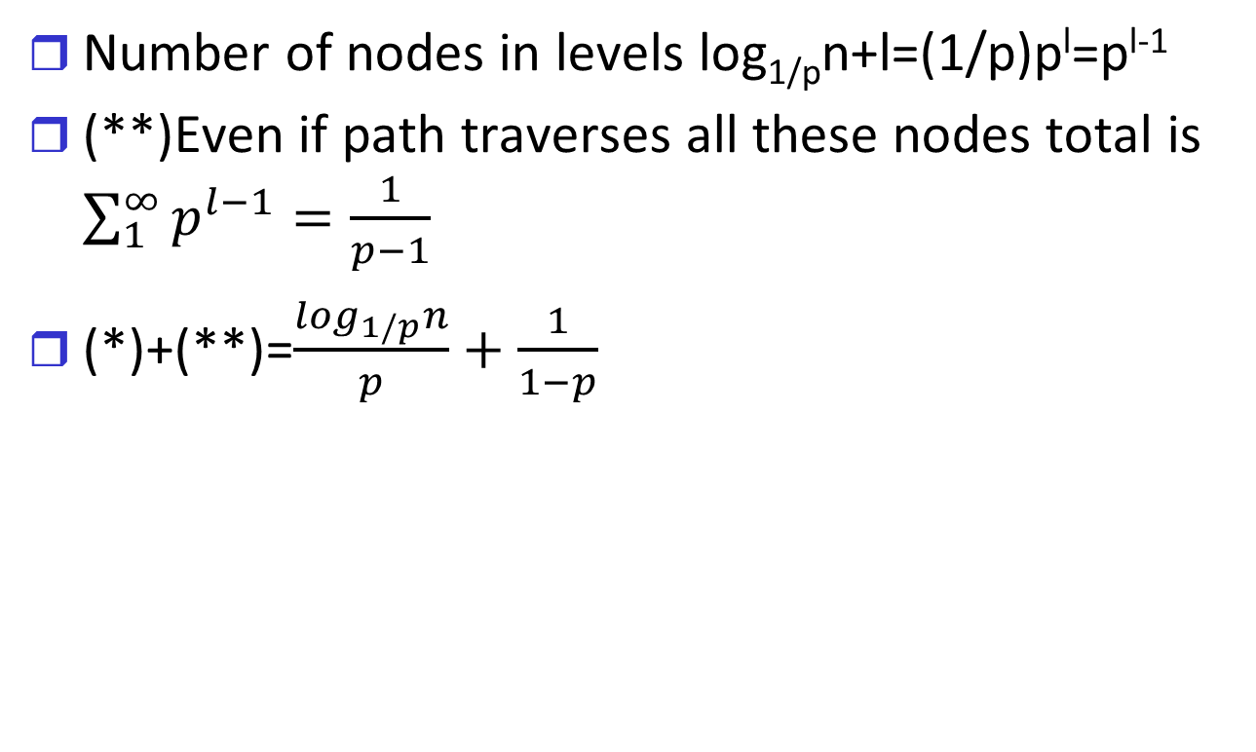
Expected Complexity of Search III
Number of nodes in levels log_{1/p}n+l=(1/p)p^{l}=p^{l-1}
(**)Even if path traverses all these nodes total is $\sum_{1}^{∞}{p^{l−1}=\frac{1}{p−1}}$
(*)+(**)=$\frac{\log_{1/p}n}{p}+\frac{1}{1−p}$

